Slide 2

WiFiMon: Introduction
Mission Statement:
“…Is it possible to gather data from multiple sources, including browser-based measurements, in addition to traditional monitoring, and extract meaningful information on the performance of a WiFi network from that data?…”

Slide 3
WiFiMon - Problem statement
At present, information for wireless networks can be reported in three ways:
Mobile End-User Device
Wireless Access Points (WAP) / WiFi-Controller
Network Management Systems (NMS)
These sources “only” allow determining if the wireless network is OK overall,
e.g., up/down
H/W probes collect performance measurements but are installed at fixed locations. We can improve our view via crowdsourced measurements.
- WiFiMon vs Ookla Speedtest: WiFiMon is transparent to the end user.
- WiFiMon is open source and reports results as experienced by end users.
- In WiFiMon, measurements are correlated with RADIUS/DHCP logs information.

Slide 4
WiFiMon - Data Flow
PERFORMANCE DATA
ANALYSE DATA
Real Time Analysis:
- Performance Data Parsing
Correlation of Performance Data with Accounting Data
(non) IEEE802.1X / eduroam enabled infrastructures:
- End-users: smartphones, laptops - Hardware Probes: RPi
Filtered RADIUS
Logs
Correlation Results
ACCOUNTING DATA
STORE DATA
CONSUME & VISUALIZE DATA
RADIUS/DHCP Logs:
- Data Filtering (Logstash)
Data Storage (Elasticsearch) - Filtered RADIUS/DHCP Logs - Correlated Results (persistent data): Performance Data correlated with RADIUS/DHCP logs
WiFiMon GUI:
- Visualisation (Kibana) for network administrator
- User Options
4

Slide 5
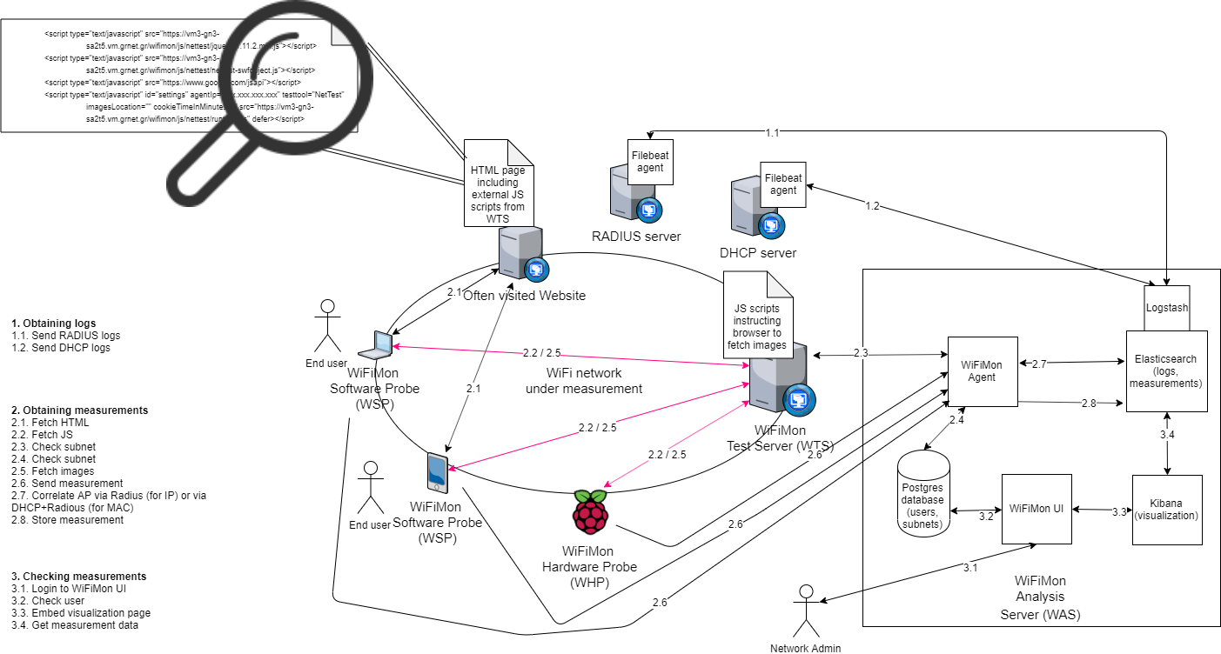
WiFiMon – Overall Architecture
WiFiMon Components:
- WiFiMon Software Probe (WSP) - WiFiMon Test Server (WTS)
- WiFiMon Hardware Probe (WHP) - WiFiMon Analysis Server (WAS)
5

Slide 6
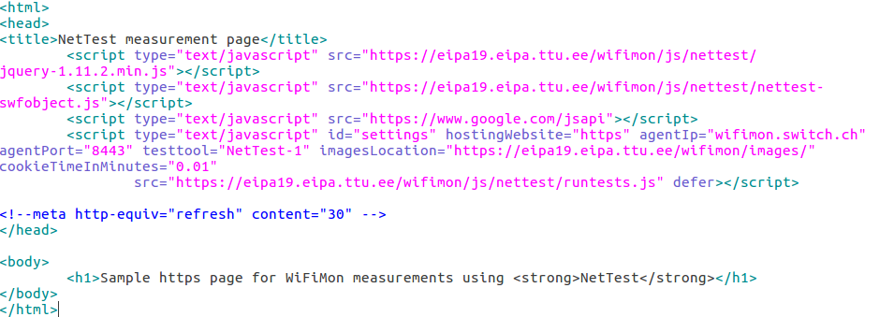
WiFiMon – Data Collection Technology
The end user visits a web page that includes JavaScript code. This triggers measurements.
Available Test Tools: Nettest, Boomerang, Speedtest
The process is collect, store, then (optionally) correlate
User Information

Slide 7
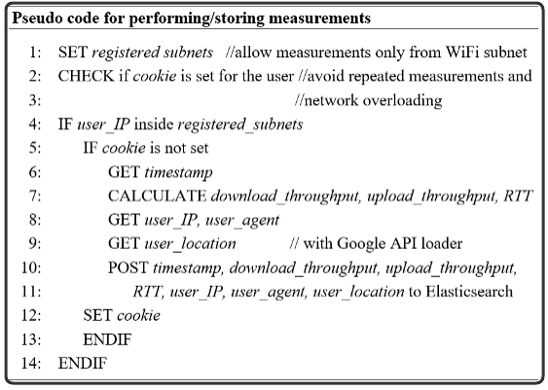
WiFiMon - Performing / Storing measurements
Network Overloading Avoidance:
Measurements accepted only from registered subnets (campus/venue)
Cookie: repeated measurements in short time intervals are not permitted
Default cookie duration is 1.5mins, can be set lower or higher

Slide 8
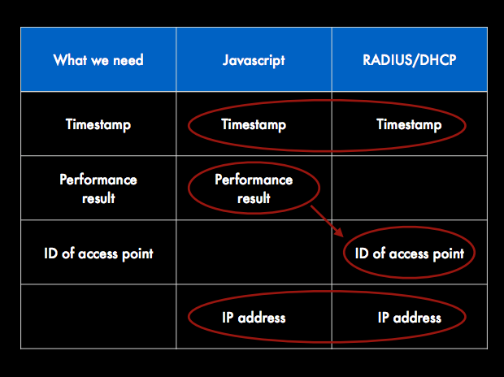
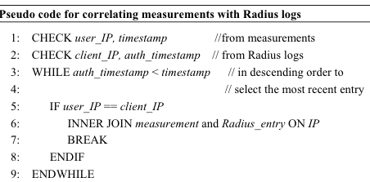
WiFiMon - How we manage/correlate performance data
The aim here is to get the most recent measurement for a given IP.
user_IP is from measurements (JavaScript)
client_IP is from RADIUS logs

Slide 9
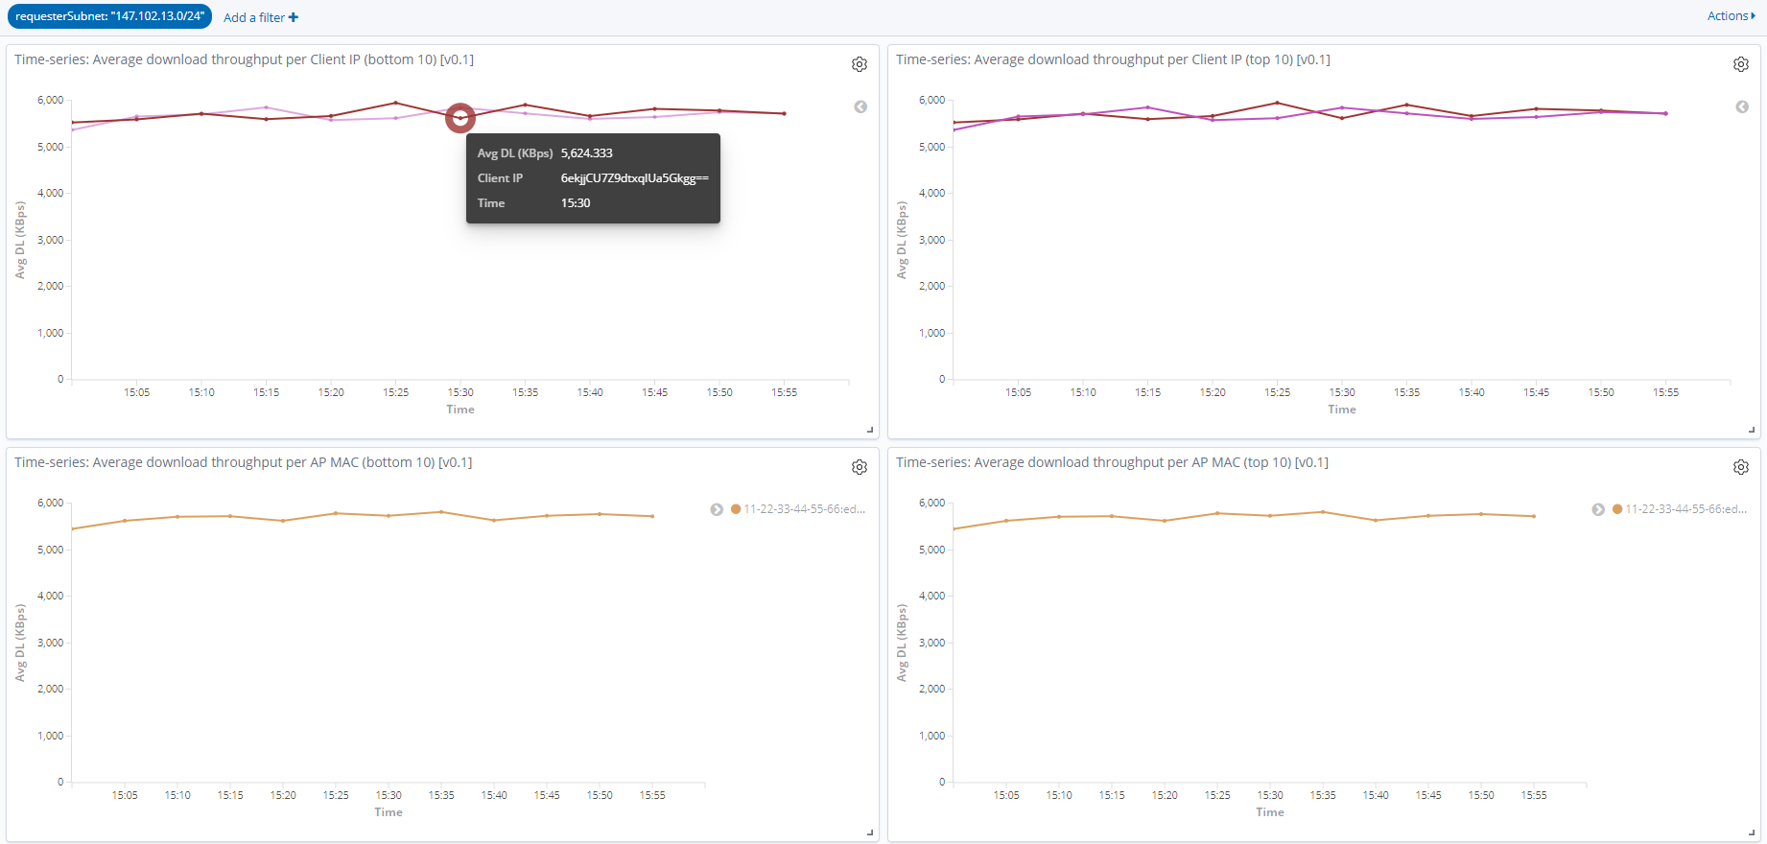
Subnets Tab (GDPR Compliance)
Client IP & MAC addresses are stored / displayed encrypted.

Slide 10
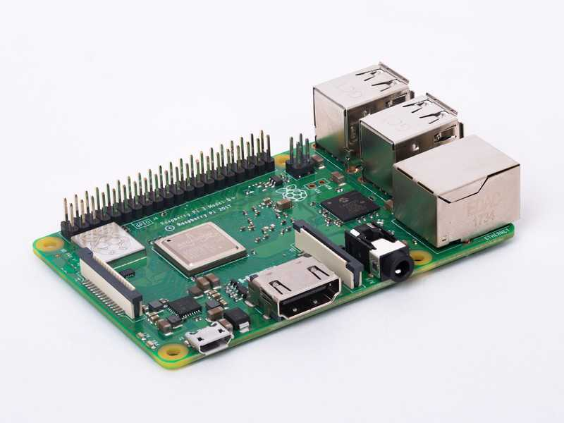
WiFiMon – Hardware Probes
Hardware Probes:
A Raspberry Pi 3 Model B+
A micro SD card with at least 16GB size
Installation Options:
- WiFiMon Raspberry Pi operating system image
(Size ~ 8 GB)
- Adaptations on an already configured Raspberry Pi

Slide 11
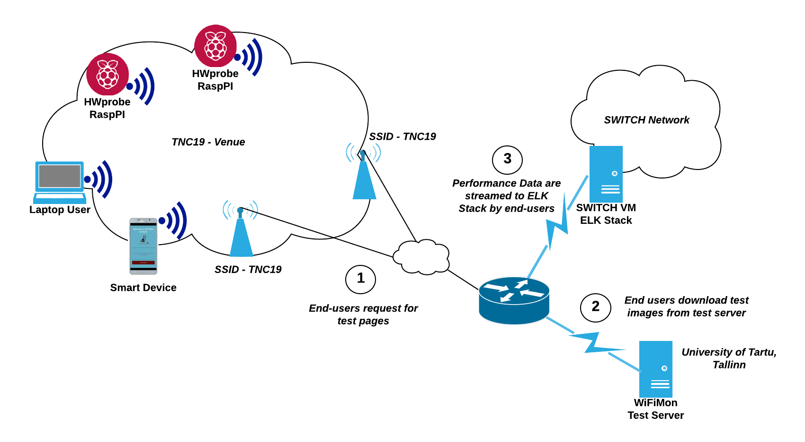
TNC19 Testbed Overview

Slide 12
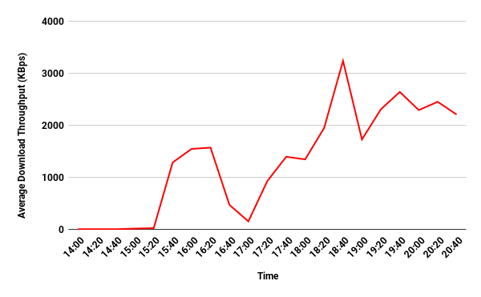
Average Download Throughput in Main Room for H/W probes,
Monday (14.00 - 21.00), Test tools average
WiFi problematic during the lightning talks plenary session (14.00 - 15.20)
WiFi OK in the afternoon when lots of people have left the main room
Worse throughput seen during the opening reception (17.00)
WiFi then OK in the evening

Slide 13
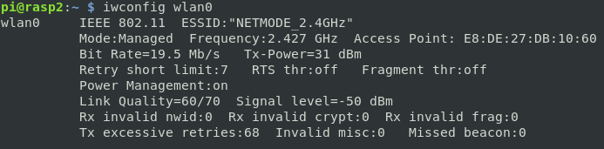
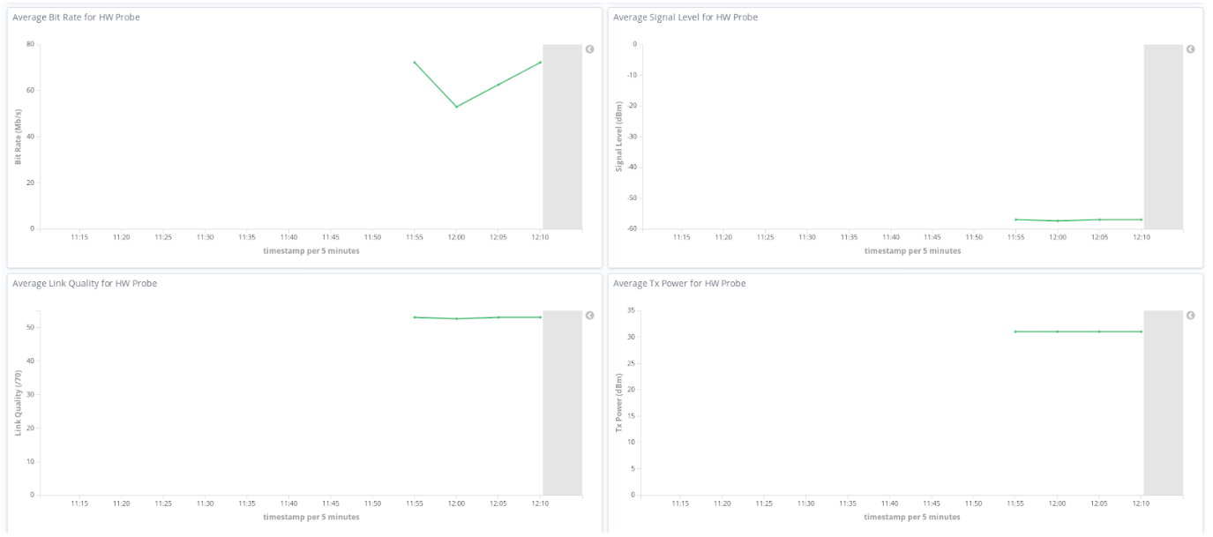
Additional Information from H/W Probes
Raspberry PI: A simple Python script parses the output of the “iwconfig” command and streams a JSON object to the WiFiMon Analysis Server (WAS) on intervals specified in a crontab.
Collected Metrics
Kibana: Visualizations to display the collected metrics per H/W Probe:

Slide 14
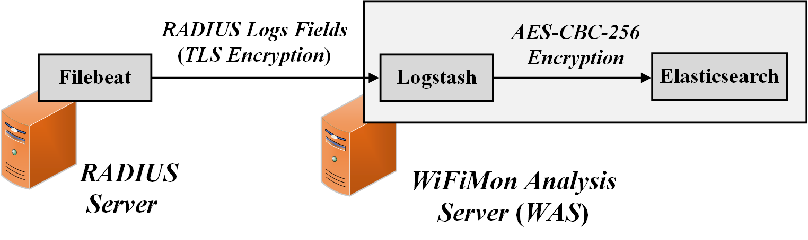
Feedback Integration – RADIUS Logs Privacy
Filebeat: RADIUS logs are streamed encrypted (TLS) to the WiFiMon Agent. Only fields of interest are streamed to reduce total size.
Logstash: RADIUS logs information is encrypted by Logstash using the algorithm also used for encrypting the end user IPs received by measurements. Thus, they are directly compared and stored encrypted in Elasticsearch.

Slide 15
Useful Links
WiFiMon wiki page: https://wiki.geant.org/display/WIF
WiFiMon code: https://bitbucket.software.geant.org/projects/WFMON/repos/agent/browse
HW Probe image: https://wiki.geant.org/display/WIF/03+WiFiMon+Hardware+Probes+Installation+Guide
Publications and Presentations: https://wiki.geant.org/display/WIF/WiFiMon+Publications

